Slide 1
Data Analysis
Budget Sales
Retail & Sales Domain
Presented by Abhishek Kumar

Slide 2
INTRODUCTION
In the first part of this presentation, we will delve into our streamlined Domain Sale process designed to help potential buyers purchase domains immediately without the need for direct seller interaction. This efficient process benefits both sellers and buyers by facilitating quick and hassle-free transactions.
In the second part, we will explore how we can leverage data from these sales to extract valuable insights. I will walk you through the steps of extracting key information such as sales figures, budget data, and customer details, and then show you how to use this data to build a comprehensive dashboard. This dashboard will help us visualize and analyze our performance, identify key metrics, and understand the relationships between various attributes.

Slide 3
Main KPIs
Total Sales Orders – 58k
Total Order lines – 27k
Total Revenue – 31.65M
Sold Unit – 91k

Slide 4
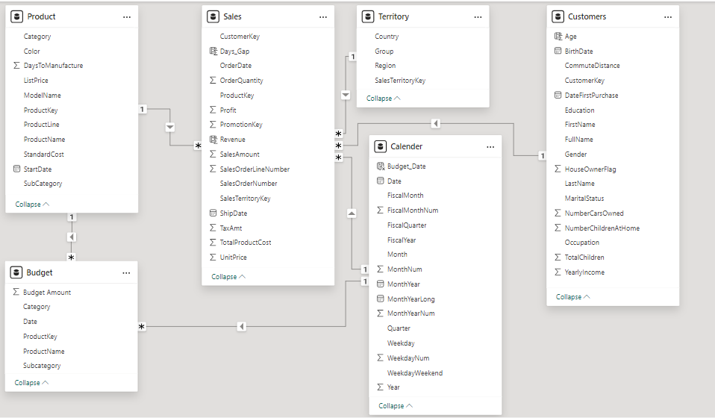

Slide 5
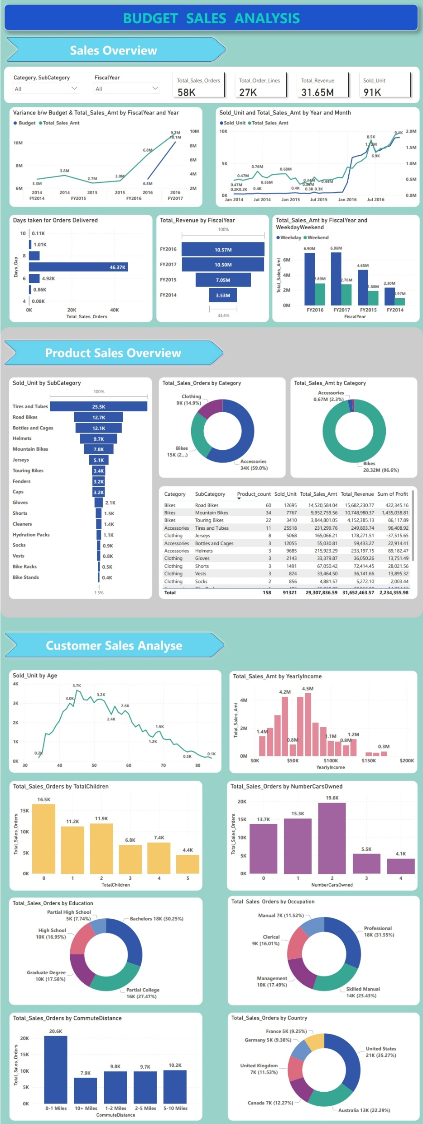

Dashboard

Slide 6
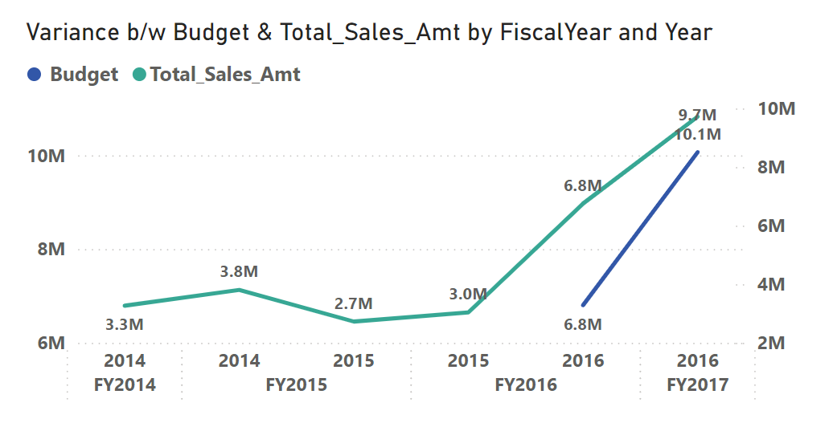
Variance b/w Budget vs Actual Sales
Insight:
Actual Sales higher than budget
FY2017 in the Year 2016 made up 59.69% of Budget.

Slide 7
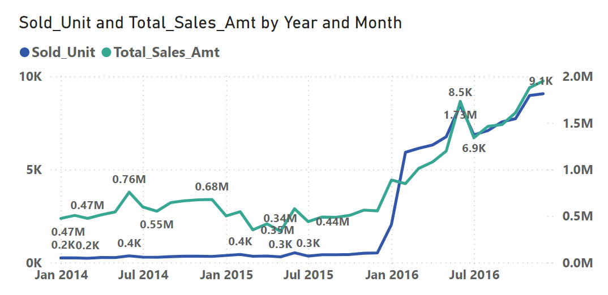
Comparison b/w Sold Unit & Sales Amt
Insight:
Total sales amount and sold units both trended up between January 2014 and December 2016.
Sold units started trending up in July 2016, rising by 32.18% (2,207 units) in 5 months.
Sold units jumped from 497 to 8,465 during its steepest incline between November 2015 and June 2016.
Total sales amount jumped from $506,399.27 to $1,949,361.11 during its steepest incline between October 2015 and December 2016.

Slide 8
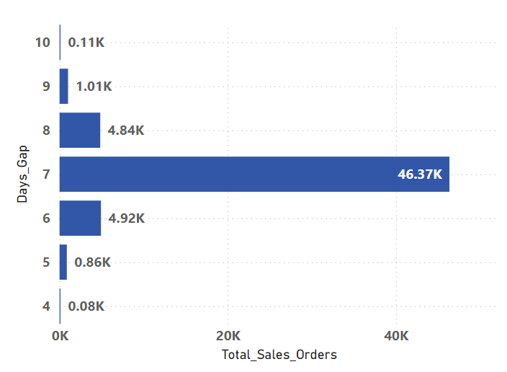
Average Days Taken For Order Delivery
Insight:
In 7 days, the highest number of orders were delivered, totaling 46,373.
This accounted for 79.69% of the total sales orders.

Slide 9
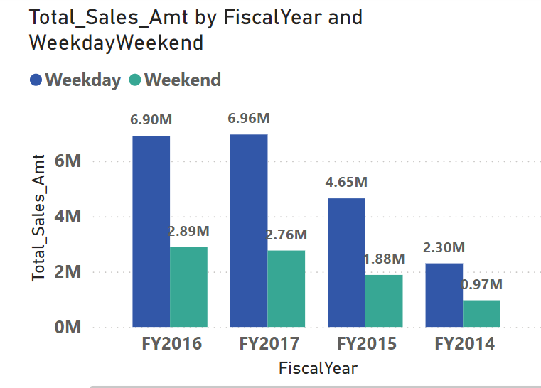
Total Revenue by Fiscal Year
Insight:
The financial years FY2016 and FY2017 earned the highest revenue.
In FY2016, the revenue was 10.57 million, and in FY2017, it was 10.50 million
Total Sales Amt was higher for Weekdays (20.81 million) than for Weekend (8.50 million).﻿﻿ ﻿﻿
﻿﻿In FY2017 Weekday made up 23.74% of Total Sales Amt.﻿

Slide 10
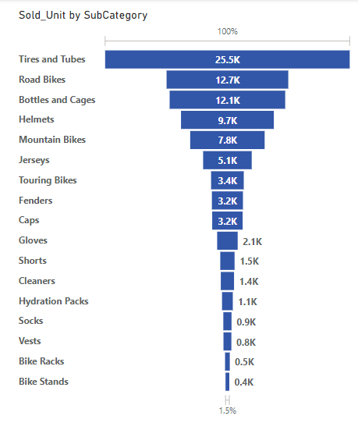
Sold Unit by Sub-Category
Insight:
At 25518, Tires and Tubes had the highest Sold Unit, and Bike Stands had the lowest Sold Unit at 394.﻿﻿ ﻿﻿
﻿﻿Tires and Tubes accounted for 27.94% of Sold Units.﻿

Slide 11
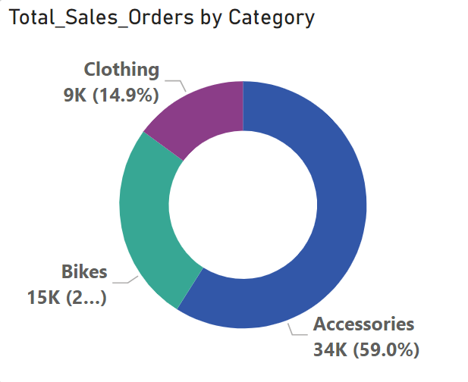
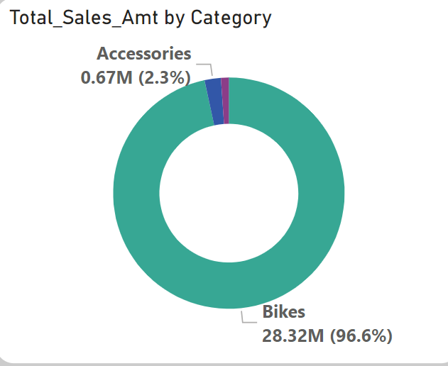
Sales Order Vs Sales Amount by Category
Insight:
﻿Accessories had the highest Total Sales Orders at 34K, followed by Bikes at 15K and Clothing at 8.6K.﻿﻿ ﻿﻿ ﻿﻿
Accessories accounted for 58.98% of Total Sales Orders.﻿
Bikes had the highest Total Sales Amt at 28.32M, followed by Accessories at 0.67M and Clothing at 0.32M.
﻿﻿Bikes accounted for 96.62% of Total Sales Amt.
Accessories had the highest sales volume but a lower sales amount compared to bikes.
Although bikes had fewer sales than accessories, they generated the highest sales amount.

Slide 12
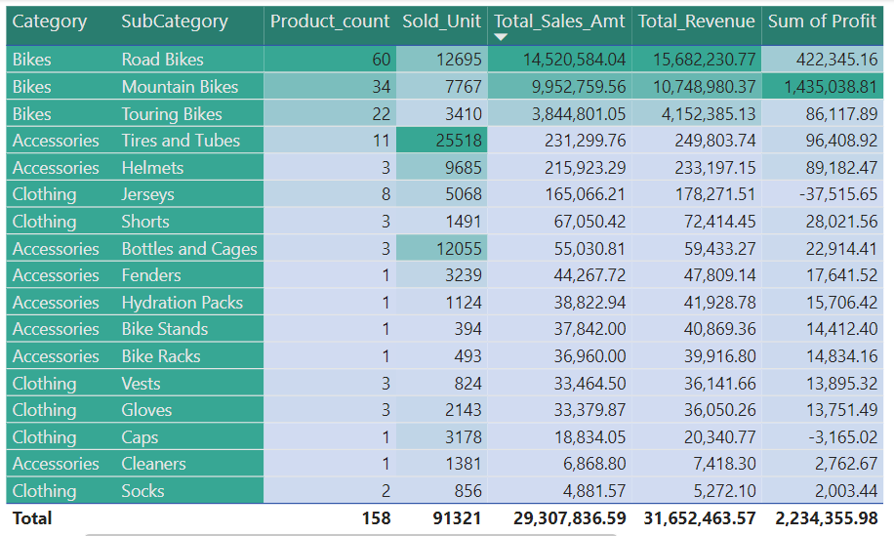
Table Chart
Note:
This table chart provides an overview of product count, sold units, total sales amount, total revenue, and sum of profit by category and subcategory.
Conditional formatting has been applied to highlight the highest and lowest values, making it easier to understand the data

Slide 13
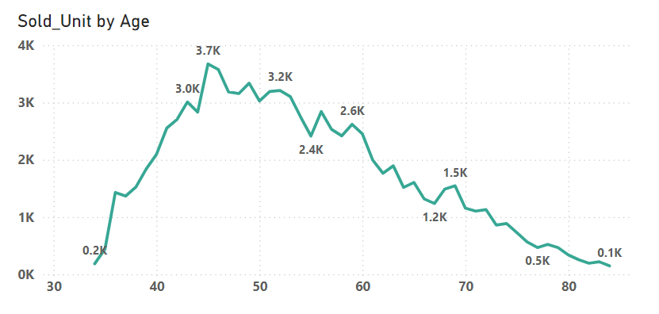
Sold Unit By Age
Insight:
Customers aged 45 had the highest Sold Unit 3674, and Customers aged 84 had the lowest Sold Unit at 148.﻿﻿ ﻿
﻿﻿45 aged customers accounted for 4.04% of Total Sales Orders.﻿﻿ ﻿﻿ ﻿﻿
Customers aged between 41 and 60 made the highest number of purchases, totaling 59.6K, which accounts for 64.61% of the total sold units.

Slide 14
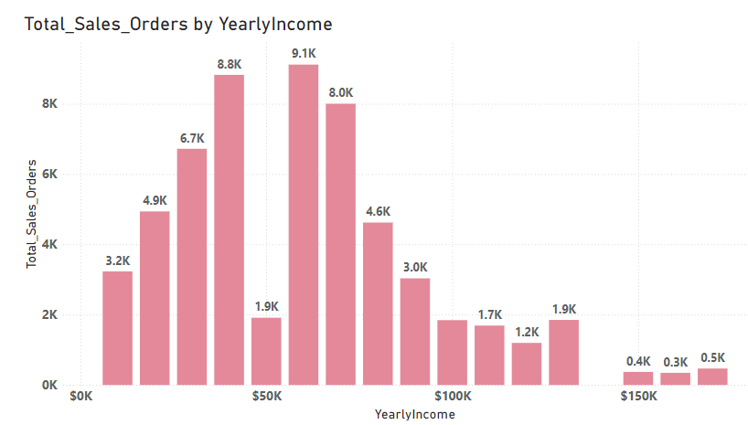
Total Sales Orders By Yearly Income
Insight:
Customers with a yearly income of $60,000 had the highest total sales orders at 9,118, while customers with a yearly income of $160,000 had the lowest total sales orders at 346.
Customers with a yearly income of $60,000 accounted for 15.67% of the total sales orders.

Slide 15
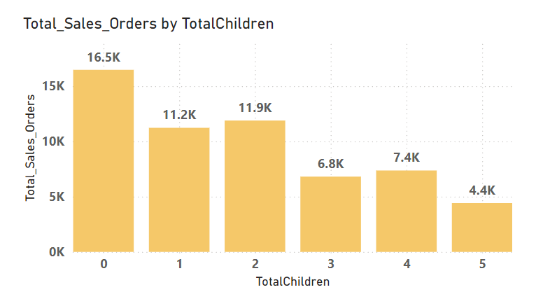
Total Sales Orders by Total Children
Insight:
Customers without children place the highest sales orders, totaling 16.5k units, whereas those with five children record the lowest sales at 4.4k units.
Interestingly, customers without children make up a significant portion, representing 28.31% of total sales orders.

Slide 16
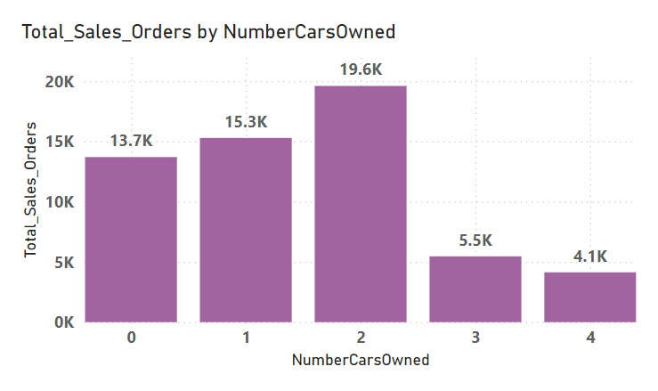
Total Sales Orders By Number Of Cars Owned
Insight:
The majority of sales orders originate from customers who own at least 2 cars, accounting for 19.6k orders.
Conversely, the lowest number of sales orders is attributed to customers who own more than 2 cars.

Slide 17
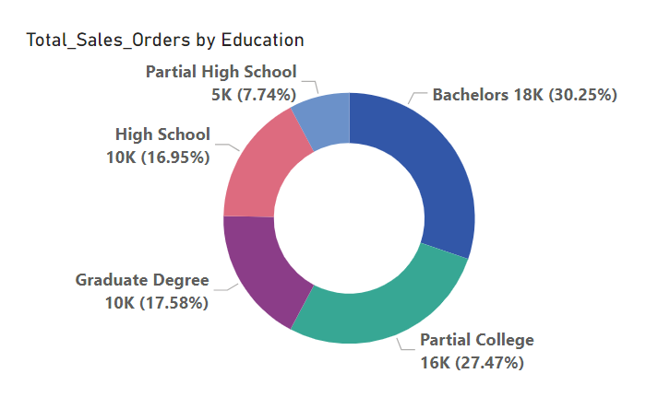
Total Sales Orders By Education
Insight:
Mostly, customers coming from a bachelor's education background accounted for 30.25% of total sales orders, which is 16k.
The least number of customers came from a partial high school background, accounting for 7.74% of total sales orders, which is 5K.

Slide 18
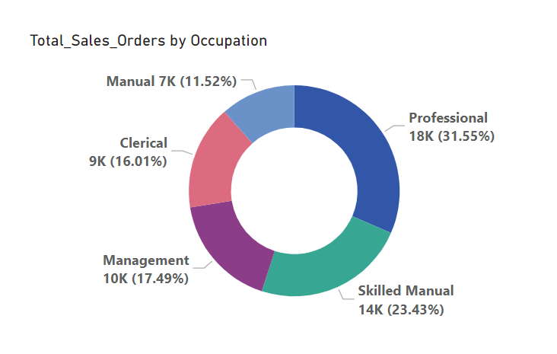
Total Sales Orders By Occupation
Insight:
Mostly, sales orders come from customers who are in professional occupations, accounted for 31.55% of total sales, which is 18K.
The least sales orders come from customers in manual occupations, accounted for 11.52% of total sales, which is 7K.

Slide 19
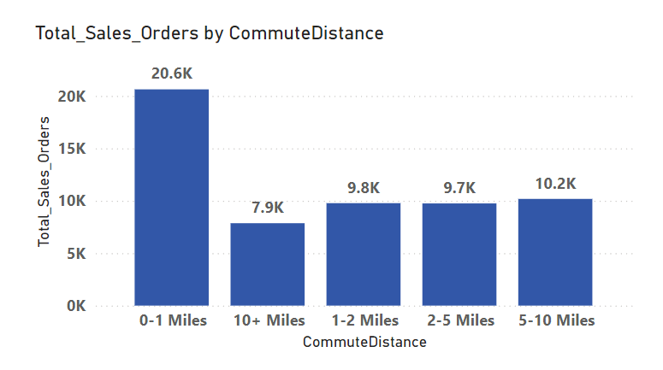
Total Sales Orders by Commute Distance
Insight:
Mostly sales orders coming from customers who have a commute distance from their home of 0-1 miles had the highest total sales orders, which is 20,628.
Customers with a commute distance from their home of 10+ miles had the lowest total sales orders, which is 7,861.
The 0-1 miles distance accounted for 35.45% of the total sales orders.

Slide 20
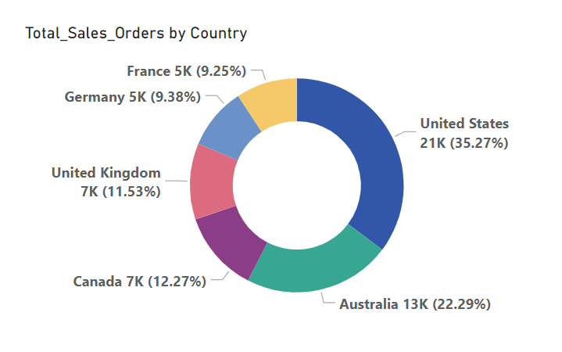
Total Sales Orders By Country
Insight:
Mostly, sales orders come from the United States, accounting for 35.27% of total sales, which is 21K.
Fewer sales orders come from France, accounting for 9.25% of total sales, which is 5K.

Slide 21
Thank You
Your thoughts & suggestions are highly appreciated!

